Slide 1
Crystal Jars
Claudia Rawn, Michelle Everett, and Marybeth Parker
University of Tennessee, Knoxville

Slide 2
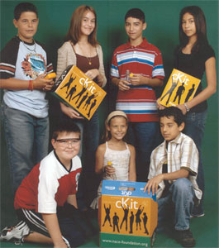


History
Last Summer during the USNCCr meeting there was a discussion of making a crystal ball kit similar to the Corrosion toolkit (cKit) distributed by the NACE Foundation.
The cKits are used in the week long Materials Camps for Teachers co-sponsored by the ASM Materials Education Foundation.

Slide 3
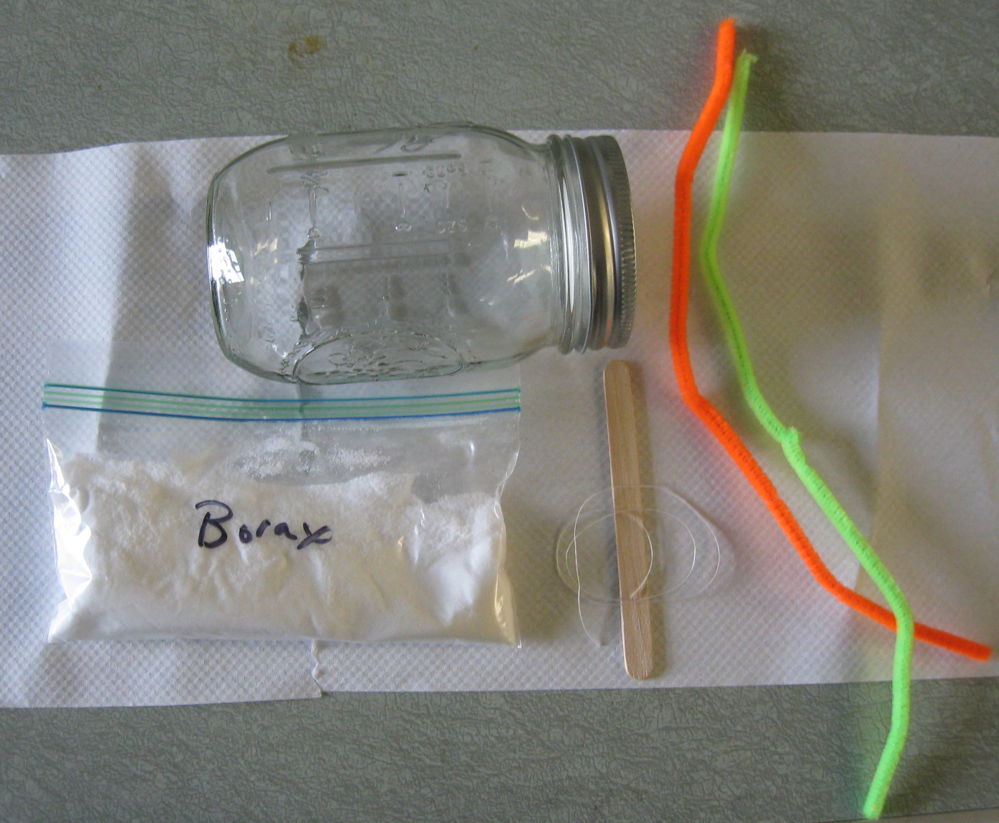
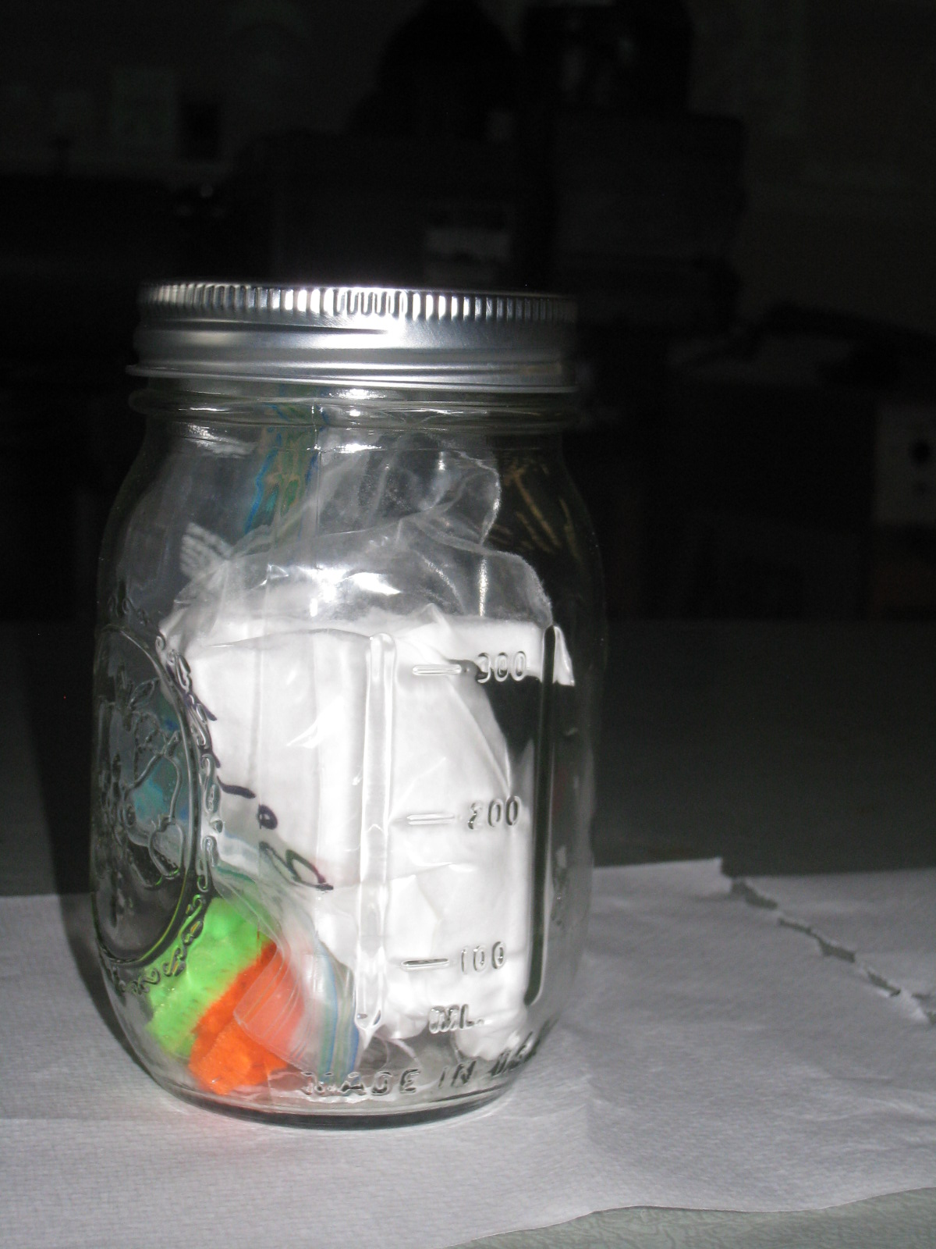
Crystal Jars – Prototype 1
Contents: Mason jar, ½ cup Borax, two pipe cleaners, popsicle stick, 18 inches of dental floss

Slide 4
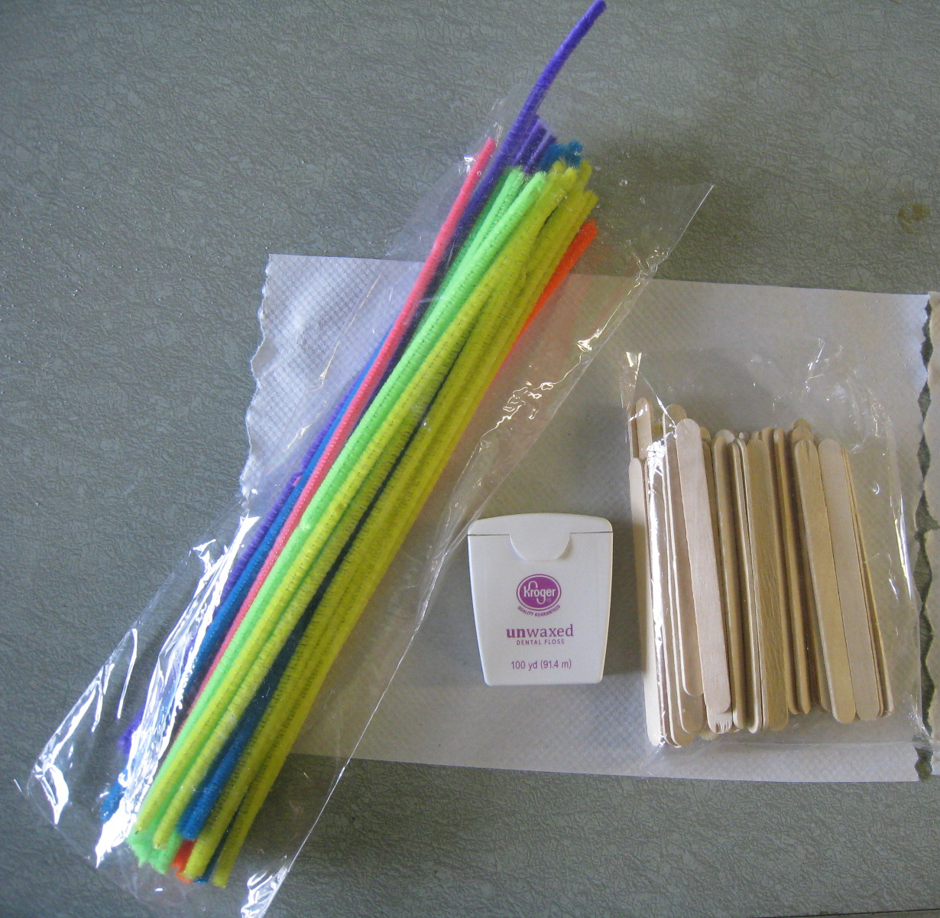
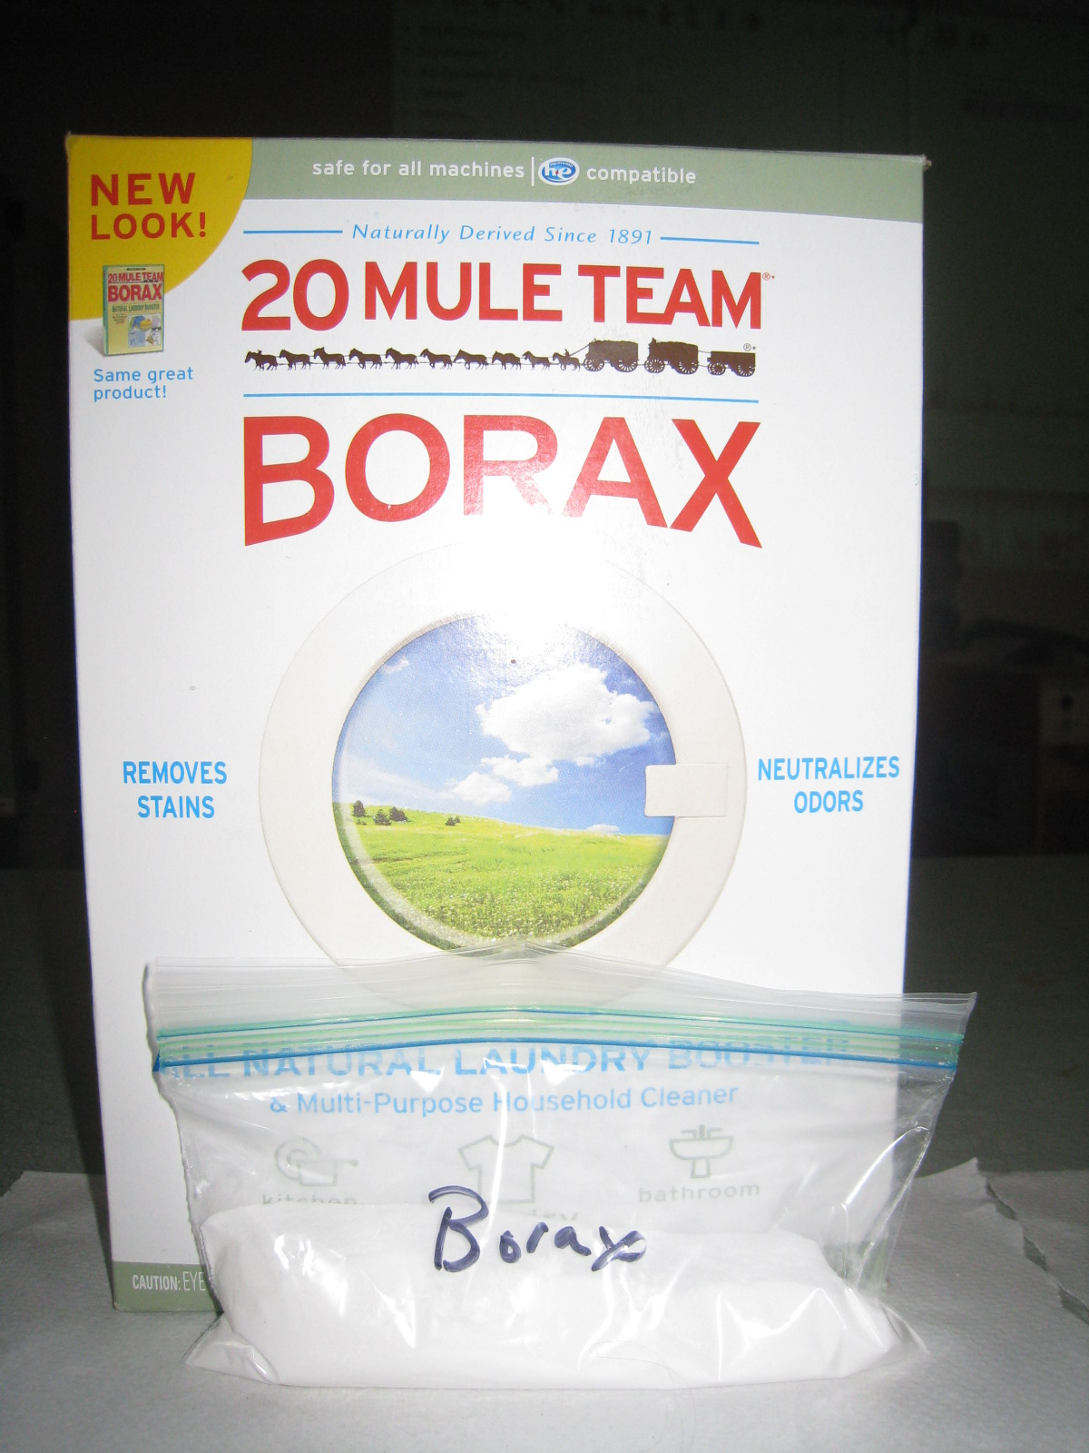
Costs
60 Crystal Jars for approximately $70
All supplies purchased at the grocery store

Slide 5
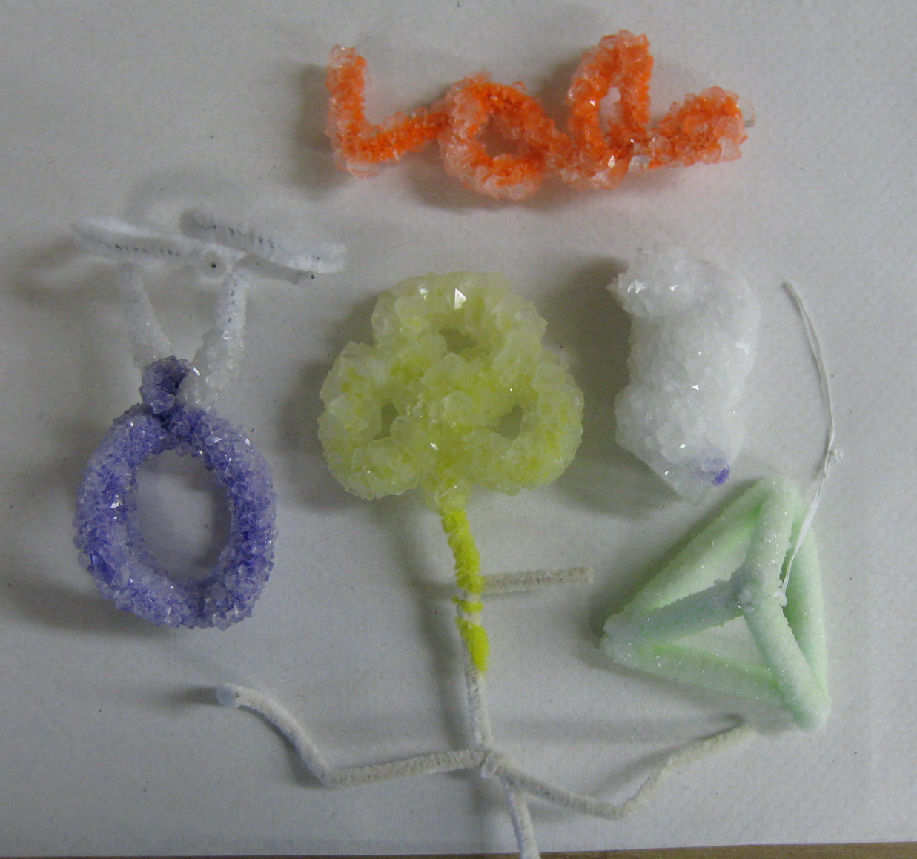
Trial Run 1
Pre-prototype 1
Materials Processing students were given a ½ cup of Borax and a pipe cleaner and asked to grow crystals
Several students experimented with cooling rates (green tetrahedron placed in freezer) and stirring (purple blob used stirring rod)

Slide 6

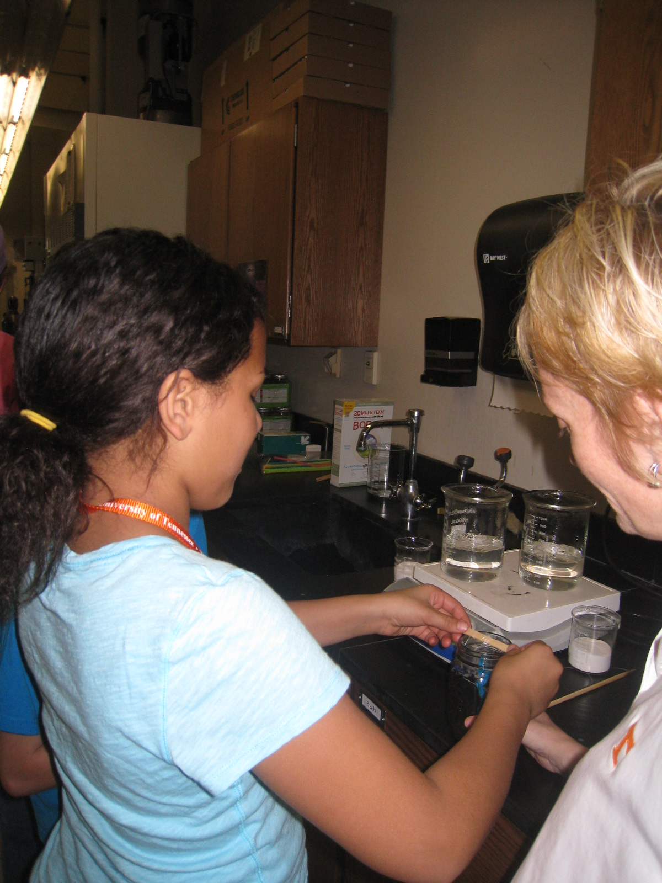
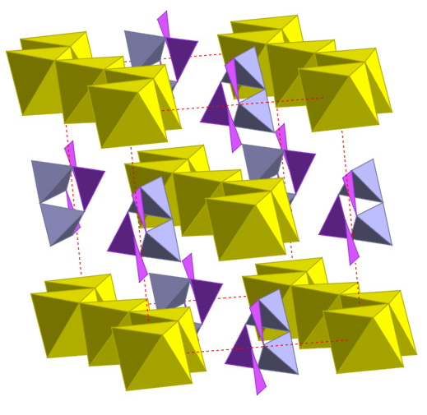
Trial Run 2 – Gadget Girls Adventures in STEM
A collaborative effort between the Girl Scout Council of the Southern Appalachians and the University of Tennessee, Knoxville
Attracted more that 150 middle school girls from southwest Virginia, eastern Tennessee, and northern Georgia – each girl that attended our session received a crystal jar to take home
14 STEM activities and growing crystals using Borax was among the activities they enjoyed the most

Slide 7
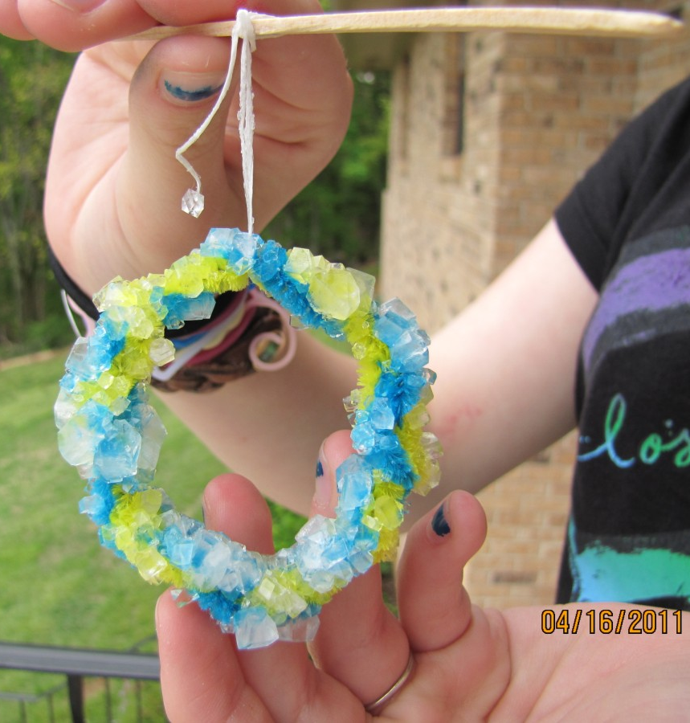
The Results
Hi Claudia,
Please find attached 2 pics of Natasha's borax crystals that she grew. Rather than boil water on the stove in a kettle, she decided to use our electric teapot. She placed the borax in the canning jar, brought the water to boil in the teapot, then poured boiling water into the jar and stirred it with a chopstick until the liquid was clear. As you can see by the picture, she decided to use the wonderful shape of a circle again. We were surprised and delighted to see one small crystal form on the end of the floss. I suggested that this was probably due to the fact that there wasn't much wax on the cut end. Natasha really enjoyed your presentation and thought it was great fun to bring a "science kit" home to be able to do it on her own.
Thank you and your staff for taking time to spend the day opening the doors of science a little wider for girl scouts.
Sincerely,
Paige L. Long

Slide 8
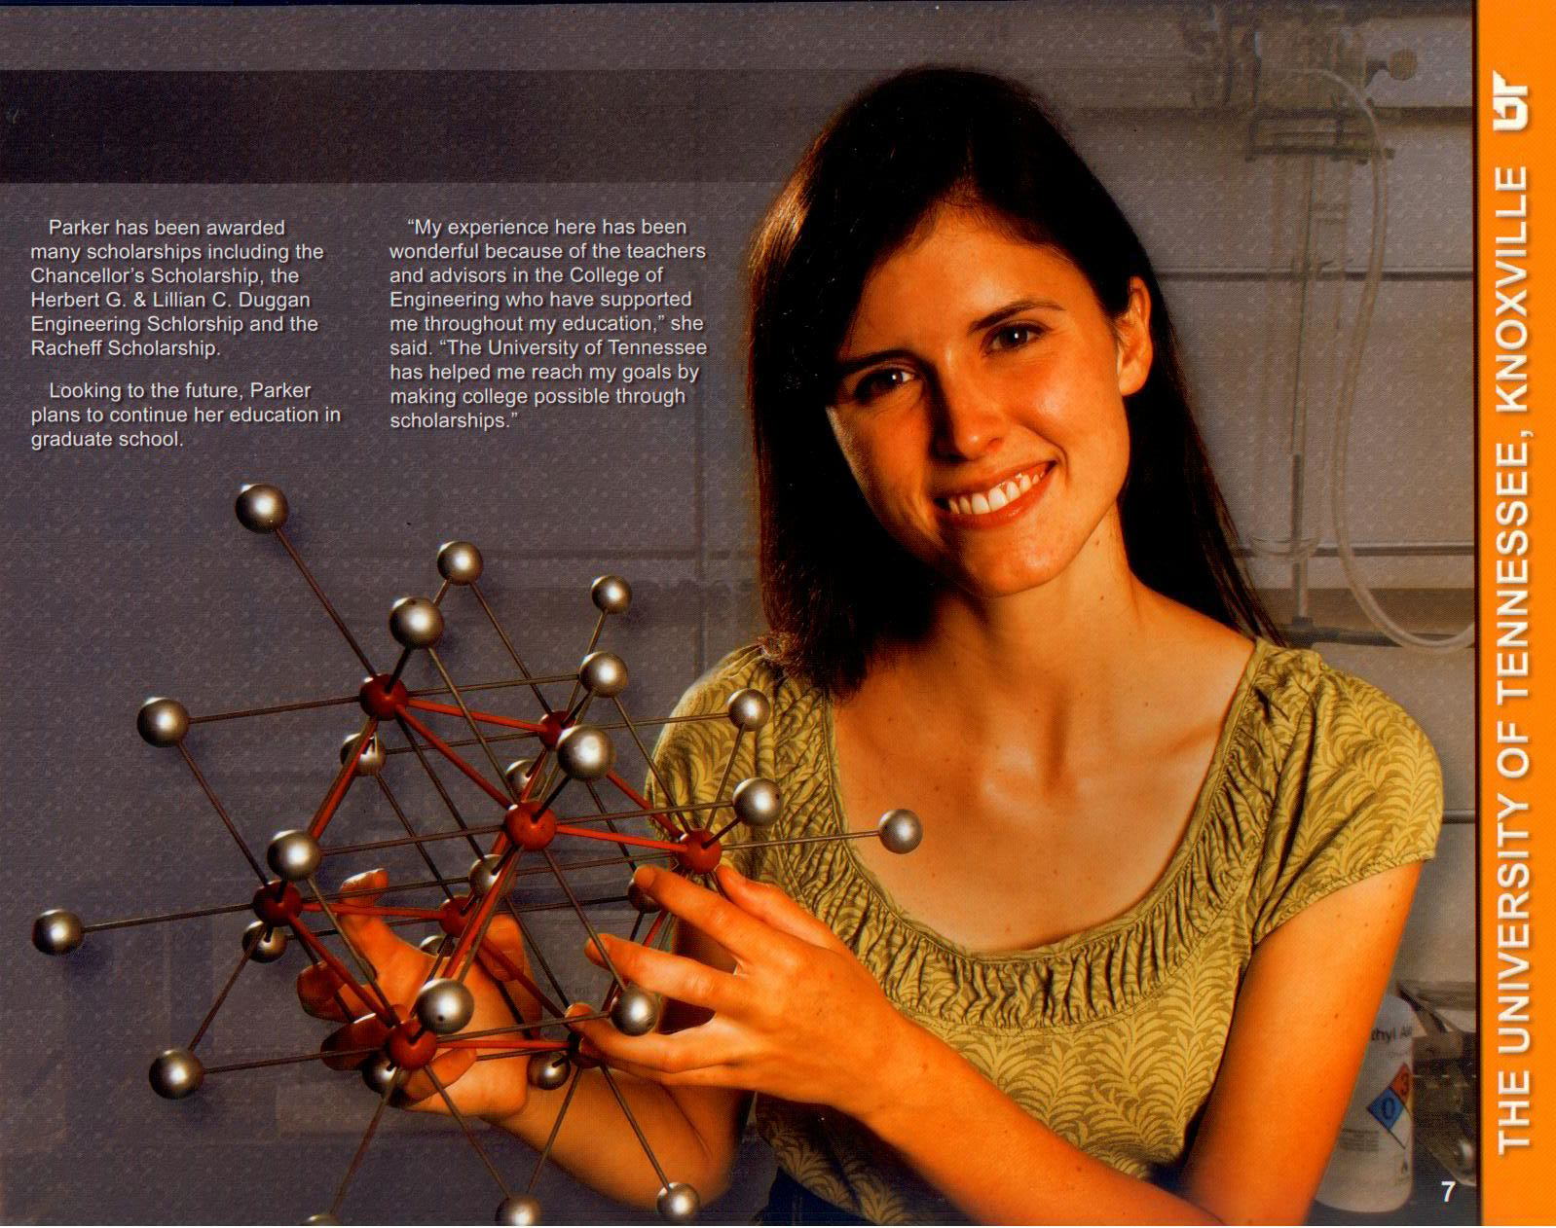
ASM Foundation Student Chapter Grant
Submitted in February 2011
Notified in April 2011 that the UTK Crystal Ball Project was selected and awarded $800
Kits to be distributed for Student and Teachers Materials Camps and to be used at local elementary and middle schools.

